Slide 1
Fossil fuel and biomass energy

Slide 2
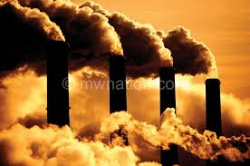
introduction to fossil fuels
Fossil fuels are natural resources ,such as coal,oil and natural gas ,containing hydrocarbons . These fuels are formed in earth over million of years and produce carbondioxide when burnt.

Slide 3
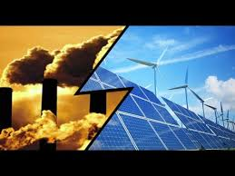
types of fossil fuel
There are three types of fossil fuels which can all be used for energy are coal, oil, and natural gas.
Coal : Coal is a solid fossil fuel formed over millions of year by decay of land vegetation. When layers are compacted and heated over time,deposits are turned into coal.
Oil: Oil is the most widely used fossil fuel which is formed from the remains of marine microorganism that were left on the bottom of the sea floor.
Natural gas : It is relatively new type of energy source that is abundant and clean compared to coal and oil. Like oil, it is formed from the remains of marine microorganisms.

Slide 4
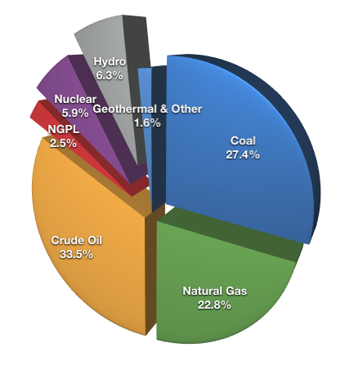
availability of fossil fuels

Slide 5
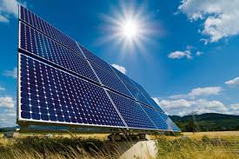
present scenario
The fossil fuels are non renewable sources so we can not depend them on forever.
Though nuclear energy is a clean and green energy , there are always some problems associated with it.
So the only option we have is solar energy because it is a nonpolluting and salient source electricity and also low maintainance and long lasting energy.

Slide 6
advantages and disadvantages of fossil fuel
They are the cheapest power plants to build,specially the coal plants.
They generate more energy than other plants .
They are much more efficient than other plants.
Burning fossil fuels releases carbondioxide.
Lowest energy density harmful by –products upon combustion.

Slide 7
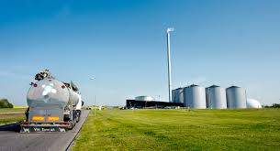
introduction to biomass energy
Biomass energy is unending and can be obtained everywhere. Morever it helps the socio- economicial development in country side.
Biomass is one of primary sources which can be used to provide renewable and clean energy.
Rapidly increasing the population and industry causes more energy need.

Slide 8

types of biomass energy
Wood and agricultural products – “ home grown ’’ energy.
Landfill gas – methane gas is collected , purifies, and used as an energy source.
Anaerobic digestors- animal waste is chemically broken down which produces methane gas.

Slide 9
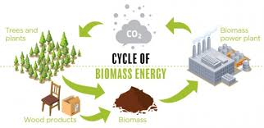
cycle

Slide 10
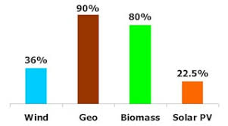
availability of biomass energy

Slide 11
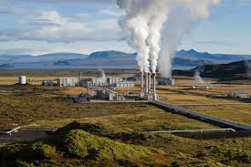
present scenario
Rapid economic development & increasing population =high demand for energy.
A sustained 8% GDP growth of india requires an annual increase of :
a) commercial energy supply from 3.7% to 6.1 % .
b) total primary energy supply from 2.2 % to 5.1%.
Limited supply of coal ,coupled with its poor quantity , low level of technologies advancements and high environmental hazards.
Limited domestic reserves and uncertain foreign supply of hydrocarbons.

Slide 12

uses of biomass
Biomass is used to heat homes, wood is burned in open fires or wood pellet boilers and stoves.
80% of biomass energy is produced for residential use.
79% of the biomass we use today comes from burning wood and chips .
18% of biomass is produced for industrial use.
2% of biomass energy is produced for transport.

Slide 13
advantages and disadvantages of biomass energy
Available throughout the world.
Reduces dependence on fossil fuels.
If trees are planted at same rate biomass is combusted, no net increase in atmospheric cardondioxide.
Requires land,water and energy
Can lead to:
a) Deforestation
b) Desertification
c) soil errosion

Slide 14
thank you
submitted by
Shivani soni

